Slide 1

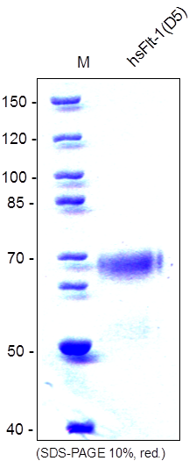
ReliaTech GmbH
Recombinant human soluble Flt-1(D5)
(Cat #S01-011 / S01-012)
Fig. 1: SDS-PAGE analysis of recombinant human soluble Flt-1(D5) derived from insect cells. Sample was loaded in 10% SDS-polyacrylamide gel under reducing conditions and stained with Coomassie blue.
http://www.reliatech.de / orders@reliatech.de

